Slide 1
Hydraulic Fracturing & Poromechanics
Brian Giffin
October 16, 2014

Slide 2
Overview
Research Goals
Approach
Poromechanics
Test Problem
Current Work

Slide 3
Research Goals
Collaboration with LLNL
Interest in modeling hydraulic fracturing
GEOS: hydraulic fracture-specific code
Main Goal: Implement a new modeling approach within GEOS

Slide 4
Approach
Homogenized (“Smeared”) Approach for Modeling Hydraulic Fracture
Treat cracked rock mass as a homogenized medium
Variable porosity and hydraulic conductivity (φ, κ)
Variable material properties (E, ν)
Evolve constitutive behavior via a damage parameter to simulate crack propagation

Slide 5
Poromechanics
Coupled solution of solid deformation and flow in a porous medium
Quasi-static deformation
Fully saturated, single phase, diffusive fluid flow
Consider a RVE to define the poroelastic solid
Φ: Initial pore volume in the reference (undeformed) configuration to the total RVE volume in the reference configuration
Φ₀: Initial pore volume in the reference (undeformed) configuration to the total RVE volume in the reference configuration

Slide 6
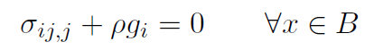
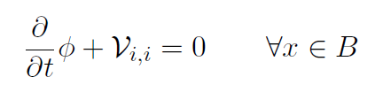
Governing Equations
Equilibrium of the Poroelastic Solid
Compressible Fluid Flow in a Porous Medium
σ_{ij}: Total stress tensor
ρ: Overall mass density per unit of initial (undeformed) volume
g_{i}: Gravitational body force (vector)
V_{i}: Volumetric fluid flux

Slide 7
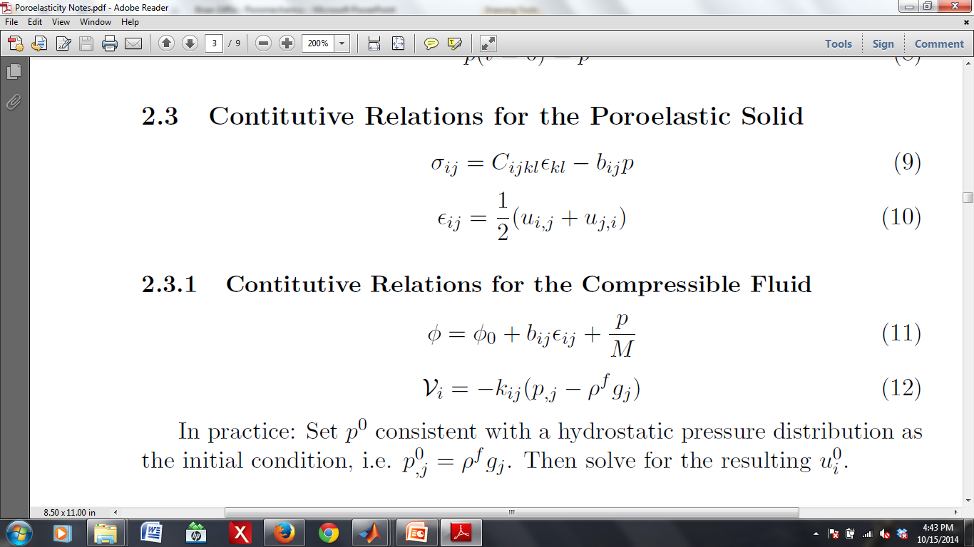
Constitutive Relations
For the Poroelastic Solid
C_{ijkl}: Tangent stiffness modulus of the “skeleton”
ε_{ij}: “Skeleton” strain tensor
b_{ij}: Biot's modulus (rank 2 tensor with non-zero components only on the
diagonal; links total stress and fluid pressure increments)
p: Fluid (pore) pressure
u_{i}: Displacement of the “skeleton”

Slide 8
Constitutive Relations
For the Compressible Fluid
1/M: Inverse of Biot's modulus (scalar valued quantity that links pore pres-
sure and porosity variation)
k_{ij}: Hydraulic conductivity tensor
ρ^{f}: Intrinsic fluid mass density

Slide 9
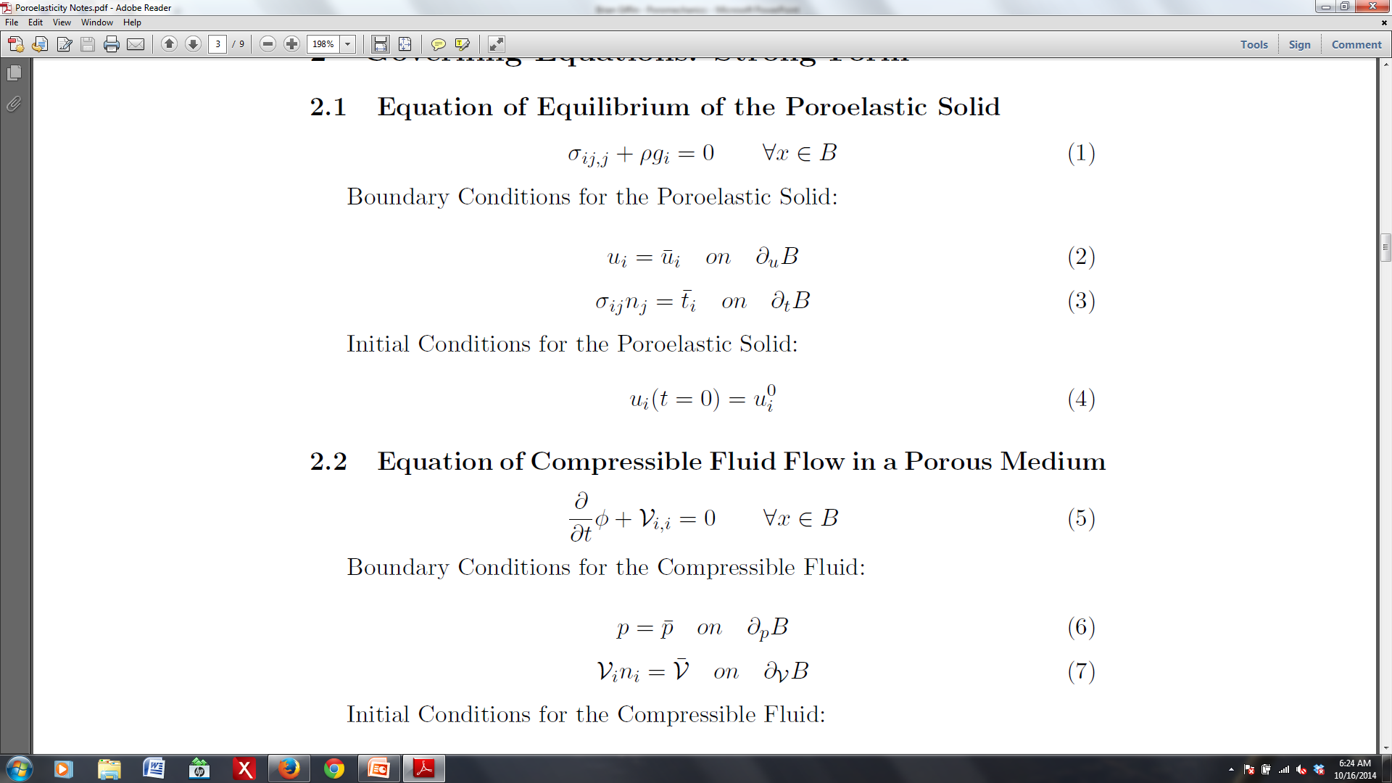
Boundary Conditions
For the Poroelastic Solid
For the Compressible Fluid

Slide 10
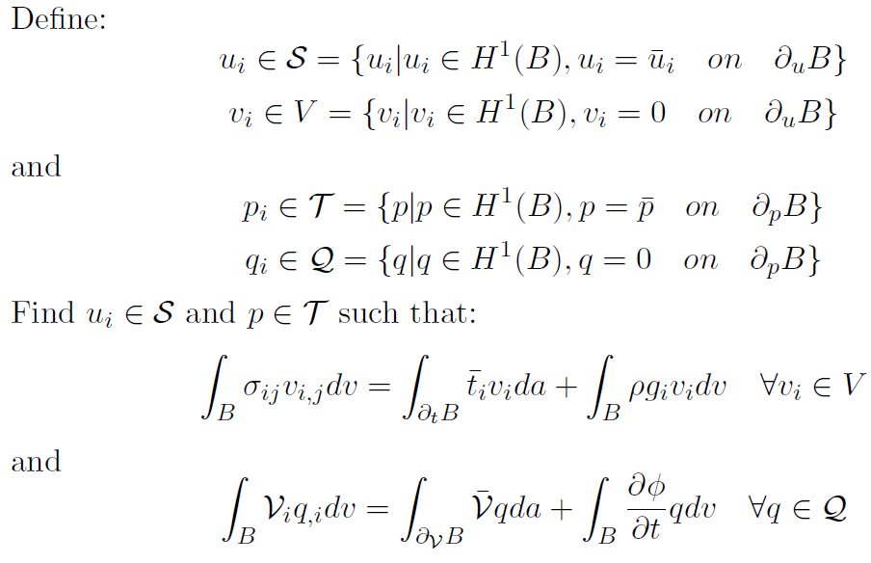
Statement of the Weak Form

Slide 11
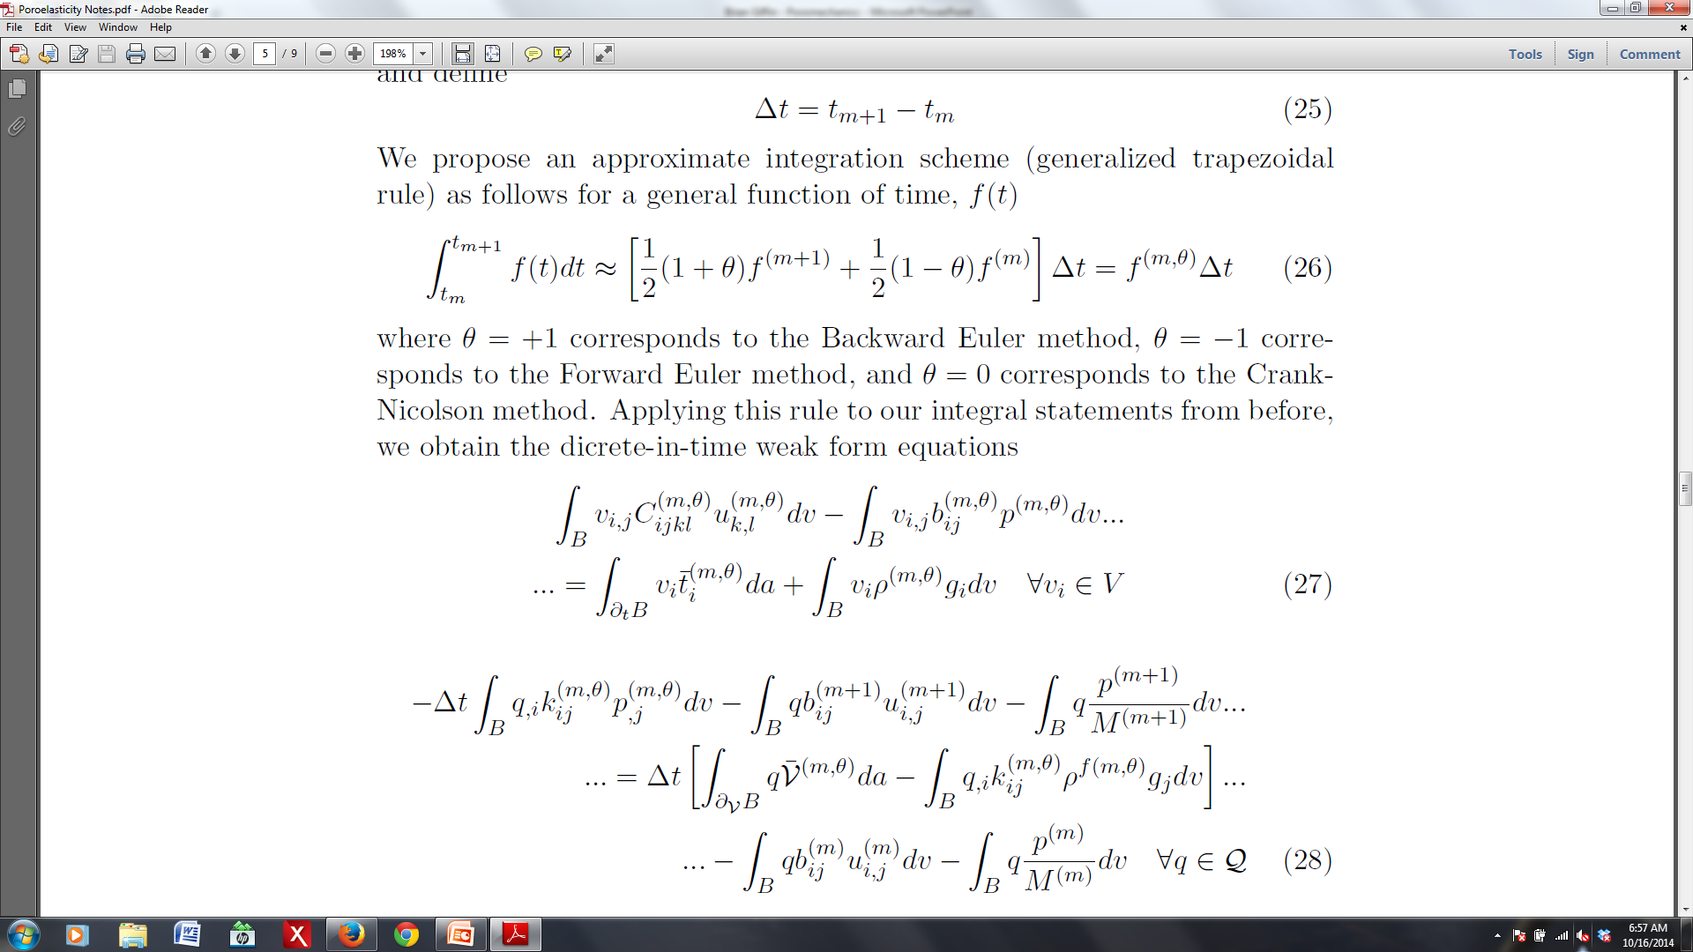
Discrete in Time Equations

Slide 12
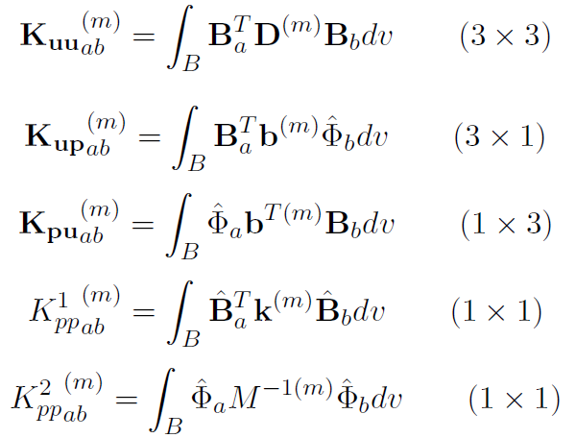
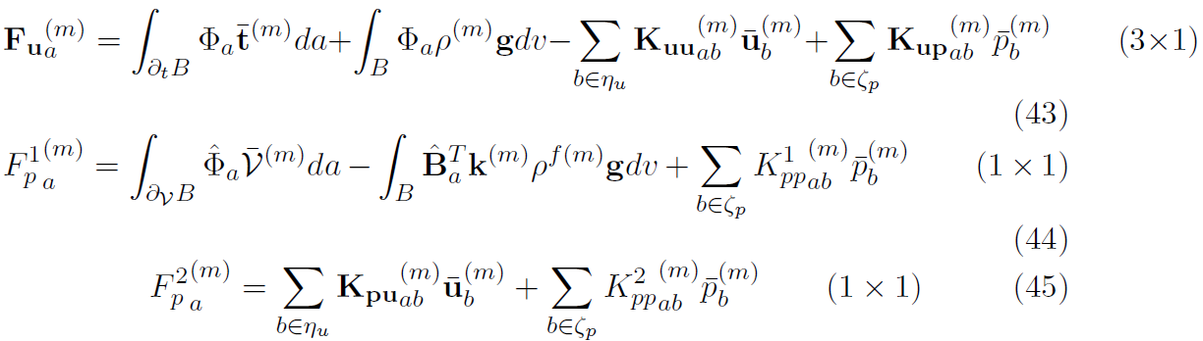
Galerkin Approximation

Slide 13
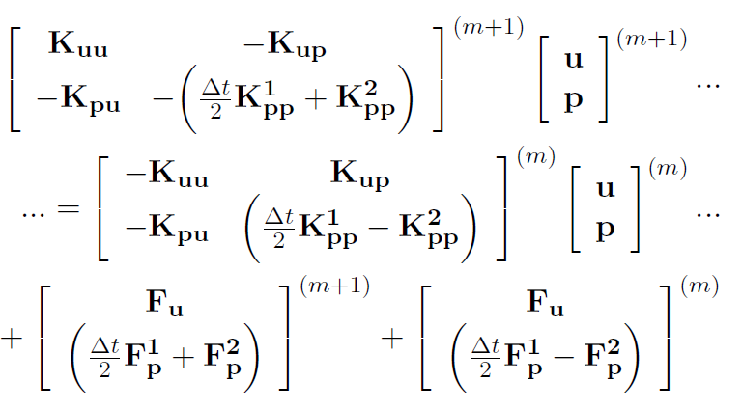
Matrix Form

Slide 14
Test Problem
2-D cube of poroelastic material subjected to an external pressure load
u_{(normal)} = 0 on
p = 0 on
V_{i}n_{i} = 0 on
σ_{(normal)j}n_{j} = - P(t) on
σ_{(transverse)j}n_{j} = 0 on

Slide 16
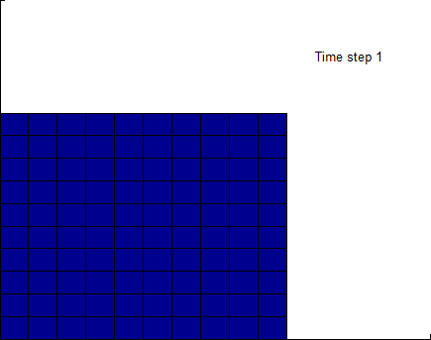
Test Problem
Material: homogeneous, isotropic, time invariant
P
t

Slide 17
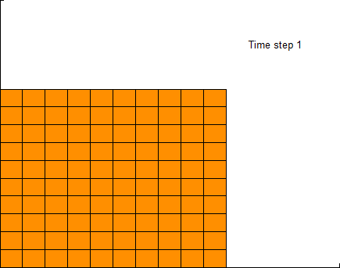
Test Problem
P(t) = constant
P
t

Slide 18
Pressure Oscillations
Known issue with coupled poromechanics
Occurs for:
Incompressibility constraint
Violation of minimum time step criterion
Can be overcome through mesh refinement
There exist several remediation techniques
Fluid pressure Laplacian stabilization (FPL)
Adds stabilization terms to the weak form

Slide 19
Test Problem
Inhomogeneous and anisotropic material properties

Slide 20
Current and Future Work
Implement a poromechanics “solver” in GEOS
Investigate methods for abating spurious pressure oscillations
Investigate anisotropic, inhomogeneous, time varying material properties
Incorporate a damage parameter with an appropriate evolution law

